Slide 1
Uncertainty

Slide 2
Outline
Uncertainty
Probability
Syntax and Semantics
Inference
Independence and Bayes' Rule

Slide 3
Uncertainty
Will A_{t} get me there on time?
Problems:
partial observability (road state, other drivers' plans, etc.)
noisy sensors (traffic reports)
uncertainty in action outcomes (flat tire, etc.)
immense complexity of modeling and predicting traffic
Hence a purely logical approach either
risks falsehood: “A₂₅ will get me there on time”, or leads to conclusions that are too weak for decision making:

Slide 4
Methods for handling uncertainty
Default or nonmonotonic logic: Assume my car does not have a flat tire Assume A₂₅ works unless contradicted by evidence
Issues: What assumptions are reasonable?
How to handle contradiction?
Rules with fudge factors:
A₂₅ |→_{0.3} get there on time
Sprinkler |→ _{0.99} WetGrass WetGrass |→ _{0.7} Rain

Slide 5
Methods for handling uncertainty
Issues: Problems with combination, e.g., Sprinkler causes Rain??
Probability
Model agent's degree of belief
Given the available evidence,
A₂₅ will get me there on time with probability 0.04

Slide 6
Probability
Probabilistic assertions summarize effects of laziness: failure to enumerate exceptions, qualifications, etc. ignorance: lack of relevant facts, initial conditions, etc.
Probabilities relate propositions to agent's own state of knowledge
e.g., P(A₂₅ | no reported accidents) = 0.06 Probabilities of propositions change with new evidence:
e.g., P(A₂₅ | no reported accidents, 5 a.m.) = 0.15

Slide 7
Making decisions under uncertainty
Suppose I believe the following: P(A₂₅ gets me there on time | …) = 0.04
P(A₉₀ gets me there on time | …) = 0.70
P(A₁₂₀ gets me there on time | …) = 0.95
P(A₁₄₄₀ gets me there on time | …)= 0.9999
Which action to choose?
Depends on my preferences for missing flight vs. time spent waiting, etc.

Slide 8
Making decisions under uncertainty
Utility theory is used to represent and infer preferences
Decision theory = probability theory + utility theory

Slide 9
Basic probabilistic notation
Basic element: random variable
Similar to propositional logic: possible worlds defined by assignment of values to random variables.
Boolean random variables
e.g., Cavity (do I have a cavity?)
Discrete random variables
e.g., Weather is one of <sunny,rainy,cloudy,snow>
Continuous random variables
e.g X<= 4.02

Slide 10
Atomic event
Atomic event: A complete specification of the state of the world about which the agent is uncertain
E.g., if the world consists of only two Boolean variables Cavity and Toothache, then there are 4 distinct atomic events:

Slide 11
Properties of atomic event
Atomic events are mutually exclusive
E.g. cavity ^ toothache and cavity ^ !toothache
The set of all possible atomic events is exhaustive. The disjunction of all atomic events is logically equivalent to be true
Any particular atomic event entails the truth or falsehood of every proposition , whether simple or complex E.g. cavity ^ !toothache entails truth of cavity and falsehood of toothache
Any proposition is logically equivalent to disjunction of all atomic events that entails the truth of the proposition

Slide 12
Prior probability
The unconditional or prior probability associated with a proposition ‘a’ is the degree of belief accorded to it in absence of any other information

Slide 13
Prior probability
Prior or unconditional probabilities of propositions
e.g., P(Cavity = true) = 0.1 and P(Weather = sunny) = 0.72 correspond to belief prior to arrival of any (new) evidence
Probability distribution gives values for all possible assignments:
P(Weather) = <0.72,0.1,0.08,0.1> (normalized, i.e., sums to 1)

Slide 14
Joint probability distribution
Joint probability distribution for a set of random variables gives the probability of every atomic event on those random variables

Slide 15
Full joint distribution
P(Weather,Cavity) = a 4 × 2 matrix of values:
Weather = sunn rainy cloudy snow
Cavity = true 0.144 0.02 0.016 0.02
Cavity = false 0.576 0.08 0.064 0.08
Every question about a domain can be answered by the joint distribution

Slide 16
Conditional probability
Conditional or posterior probabilities e.g., P(cavity | toothache) = 0.8
f we know more, e.g., cavity is also given, then we have P(cavity | toothache,cavity) = 1
New evidence may be irrelevant, allowing simplification,
e.g.,P(cavity | toothache, sunny) = P(cavity | toothache) = 0.8
This kind of inference, sanctioned by domain knowledge, is crucial

Slide 17
Conditional probability
Conditional probability in terms of unconditional probability:
P(a | b) = P(a ∧ b) / P(b) if P(b) > 0
Product rule gives an alternative formulation:
P(a ∧ b) = P(a | b) P(b) = P(b | a) P(a)
A general version holds for whole distributions, e.g., P(Weather, Cavity) = P(Weather | Cavity) P(Cavity)
(View as a set of 4 × 2 equations, not matrix mult.)

Slide 18
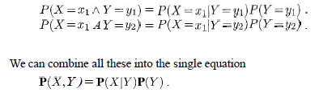
Conditional probability distribution

Slide 19
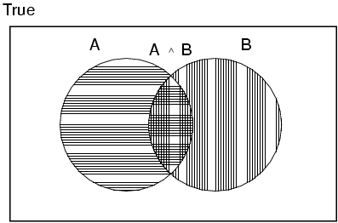
Axioms of probability – Kolmogorov’s axiom
For any propositions A, B
0 ≤ P(A) ≤ 1
P(true) = 1 and P(false) = 0
P(A ∨ B) = P(A) + P(B) - P(A ∧ B)

Slide 20

Using the axiom of probability

Slide 21

Prob distribution on a single variable
Probability distribution on a single variable must sum to 1

Slide 22

Probability of proposition – atomic events
Probability of a proposition equal to the sum of the probabilities of the atomic events in which it holds

Slide 23
Conditional probability
Chain rule is derived by successive application of product rule:
P(X₁, …,X_{n}) = P(X₁,...,X_{n-1}) P(X_{n} | X₁,...,X_{n-1})
= P(X₁,...,X_{n-2}) P(X_{n-1} | X₁,...,X_{n-2}) P(X_{n} | X₁,...,X_{n-1})
= …
= π_{i= 1}^n P(X_{i} | X₁, … ,X_{i-1})

Slide 24


Marginalisation

Slide 25

Marginalisation – conditional probability

Slide 26
Inference by enumeration
Start with the joint probability distribution:
For any proposition φ, sum the atomic events where it is true: P(φ) = Σ_{ω:ω╞φ} P(ω)

Slide 27

Inference by enumeration
Start with the joint probability distribution:
For any proposition φ, sum the atomic events where it is true: P(φ) = Σ_{ω:ω╞φ} P(ω)
P(toothache) = 0.108 + 0.012 + 0.016 + 0.064 = 0.2

Slide 28

Inference by enumeration
Start with the joint probability distribution:
Can also compute conditional probabilities:
P(¬cavity | toothache) = P(¬cavity ∧ toothache)
P(toothache)
= (0.016+0.064) (0.108 + 0.012 +
0.016 + 0.064)
= 0.4

Slide 29
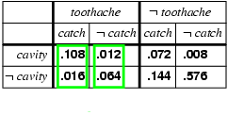
Normalization
Denominator can be viewed as a normalization constant α
P(Cavity | toothache) = α, P(Cavity,toothache)
= α, [P(Cavity,toothache,catch) + P(Cavity,toothache,¬ catch)]
= α, [<0.108,0.016> + <0.012,0.064>]
= α, <0.12,0.08> = <0.6,0.4>
General idea: compute distribution on query variable by fixing evidence variables and summing over hidden variables

Slide 30
Inference by enumeration, contd.
Typically, we are interested in
the posterior joint distribution of the query variables Y
given specific values e for the evidence variables E
Let the hidden variables be H = X - Y – E
Then the required summation of joint entries is done by summing out the hidden variables:
P(Y | E = e) = αP(Y,E = e) = αΣ_{h}P(Y,E= e, H = h)
The terms in the summation are joint entries because Y, E and H together exhaust the set of random variables

Slide 31
Inference by enumeration, contd.
Obvious problems:
Worst-case time complexity O(d^{n}) where d is the largest arity
Space complexity O(d^{n}) to store the joint distribution
How to find the numbers for O(d^{n}) entries?

Slide 32
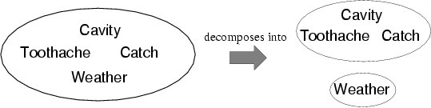
Independence
A and B are independent iff
P(A|B) = P(A) or P(B|A) = P(B) or P(A, B) = P(A) P(B)
P(Toothache, Catch, Cavity, Weather)
= P(Toothache, Catch, Cavity) P(Weather)
32 entries reduced to 12; for n independent biased coins, O(2^{n}) →O(n) Absolute independence powerful but rare Dentistry is a large field with hundreds of variables, none of which are independent. What to do?

Slide 33
Bayes' Rule
Product rule P(a∧b) = P(a | b) P(b) = P(b | a) P(a)
⇒ Bayes' rule: P(a | b) = P(b | a) P(a) / P(b)
or in distribution form
P(Y|X) = P(X|Y) P(Y) / P(X) = αP(X|Y) P(Y)

Slide 34
Bayes' Rule
Useful for assessing diagnostic probability from causal probability:
P(Cause|Effect) = P(Effect|Cause) P(Cause) / P(Effect)
E.g., let M be meningitis, S be stiff neck:
P(m|s) = P(s|m) P(m) / P(s) = 0.8 × 0.0001 / 0.1 = 0.0008
Note: posterior probability of meningitis still very small!

Slide 35
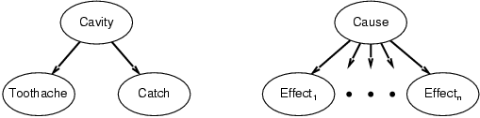
Bayes' Rule and conditional independence
P(Cavity | toothache ∧ catch)
= αP(toothache ∧ catch | Cavity) P(Cavity)
= αP(toothache | Cavity) P(catch | Cavity) P(Cavity)
This is an example of a naïve Bayes model: P(Cause,Effect₁, … ,Effect_{n}) = P(Cause) π_{i}P(Effect_{i}|Cause)
Total number of parameters is linear in n

Slide 36
Summary
Probability is a rigorous formalism for uncertain knowledge
Joint probability distribution specifies probability of every atomic event
Queries can be answered by summing over atomic events
For nontrivial domains, we must find a way to reduce the joint size
Independence and conditional independence provide the tools

